Slide 1

Pascoe Vale Central Cricket Club
Website plan

Slide 2
Sitemap
About
Teams
Merch
News & events
Contact
History
Senior’s
Basic shop page where we can take orders on club apparel (beanies, etc)/
Blog style page where the club can post news updates, weekly captain’s reports or promote events (ladies day, raffles, etc.)
Sponsors
Junior’s
Committee
Women’s
Legends Club
Life members

Slide 3

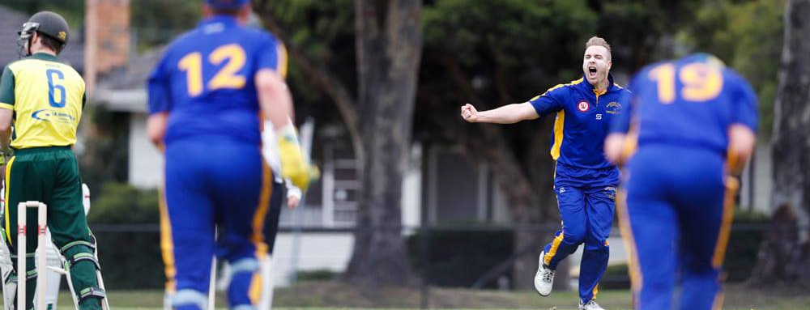
Homepage
About
Teams
Merch
News & Events
Contact
1/3

Slide 4
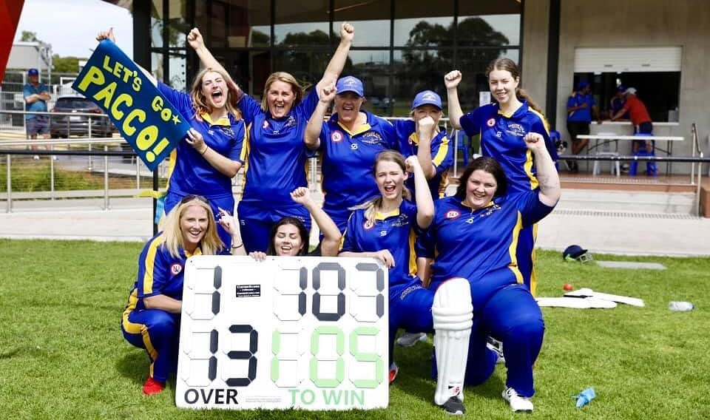
Homepage
About PVCCC
Founded in 1928, Pascoe Vale Central Cricket Club (PVCCC) has a long and proud history of more than 90 years.
From our humble beginnings, we are now the largest and most successful club in the North West Metropolitan Cricket Association (NWMCA), with seven senior sides, four junior sides and one women’s team.
We have always been a family club with a strong social atmosphere – but that doesn’t stop us from being competitive on the field.
WOMEN’S TEAM INTO THEIR FIRST GRAND FINAL
The PVCCC Women’s T20 side are heading to their first grand final where they’ll take on reigning champions Keilor Park.
<
>
VIEW ALL NEWS & EVENTS
2/3

Slide 5
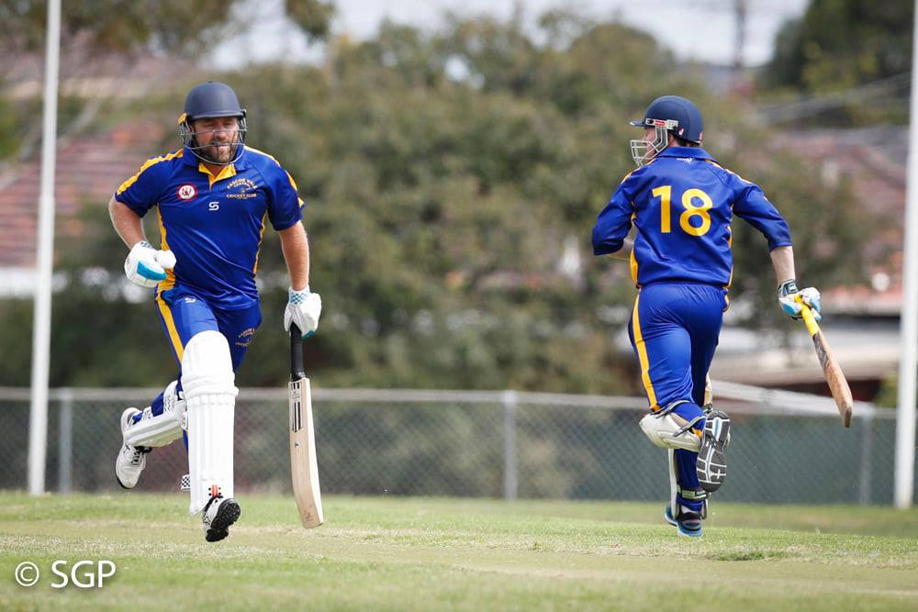
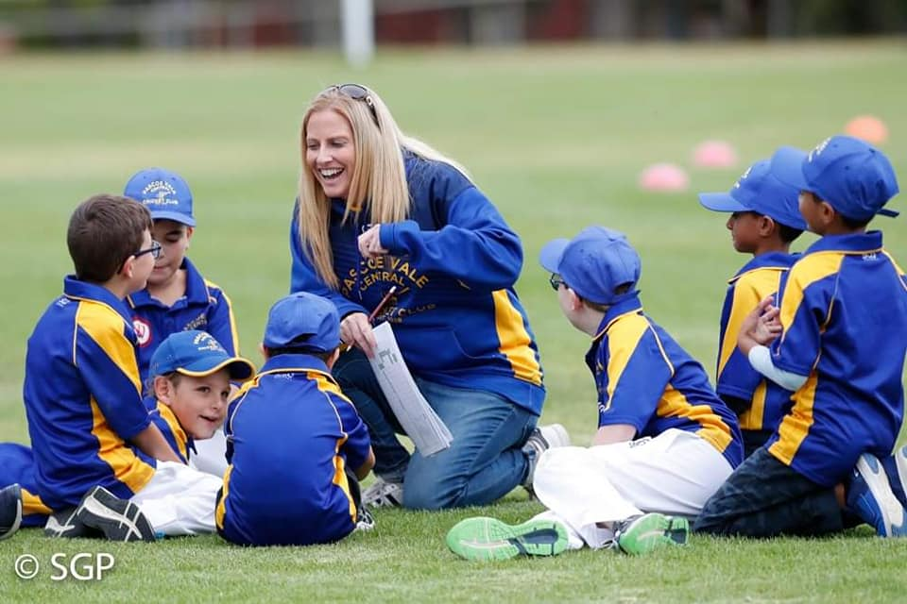
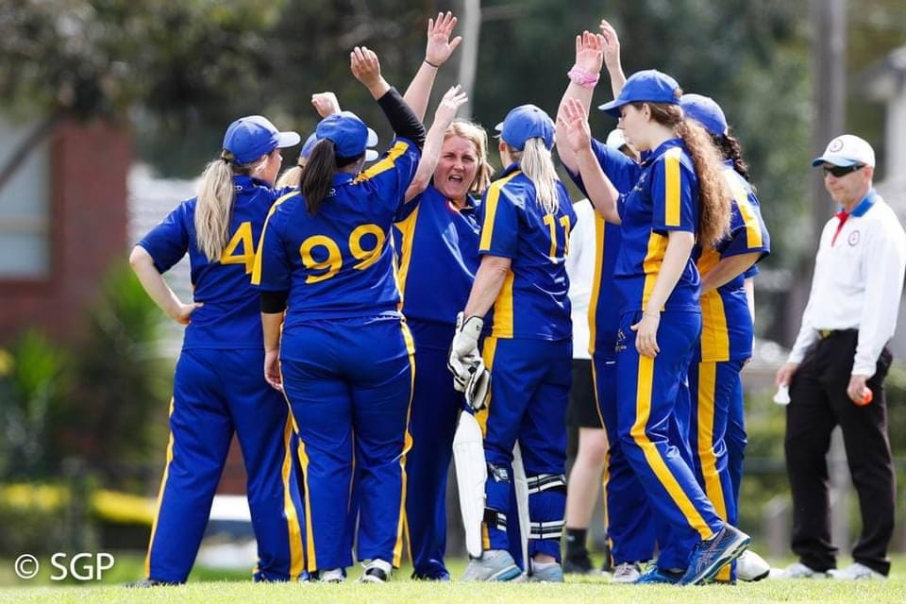


Homepage
Teams
#AlwaysPacco
Club policies
Privacy
Contact
SENIOR’S
JUNIOR’S
WOMEN’S
<
>
#AlwaysPacco
Club policies
Privacy
Contact
3/3

Slide 6
Homepage
Fixtures
Results
#AlwaysPacco
Club policies
Privacy
Contact
<
VIEW ALL FIXTURES & RESULTS
>
#AlwaysPacco
Club policies
Privacy
Contact
3/3

Slide 7
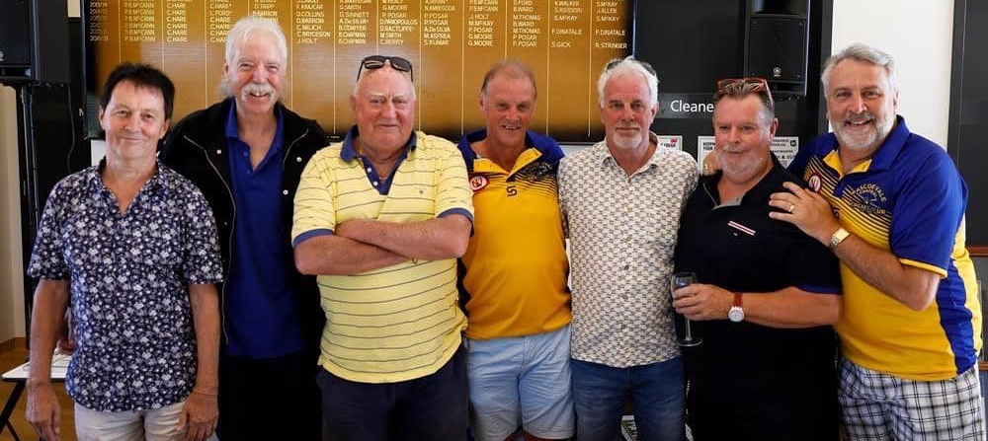
Legends Club
About
Senior’s
Junior’s
Women’s
News & Events
Contact
Legends Club
1/3

Slide 8
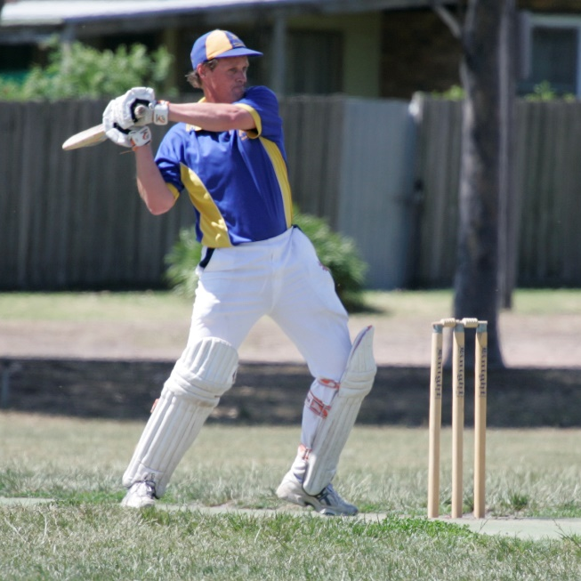
Legends Club
PAUL MCCANN
COLIN MCKAY
MARK NEILSON
#AlwaysPacco
Club policies
Privacy
Contact
<
>
2/3

Slide 9
Legends Club
Paul McCann
Paul is the longest-serving President of PVCCC, serving from 1996 to present – 25 years and counting.
As the son of legendary club bowler Ian McCann, Paul has been part of the PVCCC family since the day he was born. Paul played his first match for the club in the Junior’s in 1973 before moving to the Senior’s in 1975. He is now the club record holder for most senior games played – 484 games over 46 years at the end of the 2020/21 season.
His form on field is impressive, having scored close to 10,000 runs for the club (9850 after season 2020/21), with nine batting averages including one competition average. Paul has also won six Club Best Fielder awards, taking more than 200 catches in his time.
Paul’s leadership at PVCCC extends to captaining the 1sts, 2nds and 4ths and coaching the Junior’s to four premierships over 14 years.
Paul was inducted into the Hall of Fame in 2019, joining his father Ian, and is part of the PVCCC 400 Club, NWMCA Black and Red Club and a PVCCC Life Member.
#AlwaysPacco
Club policies
Privacy
Contact
<
>
3/3

Slide 10
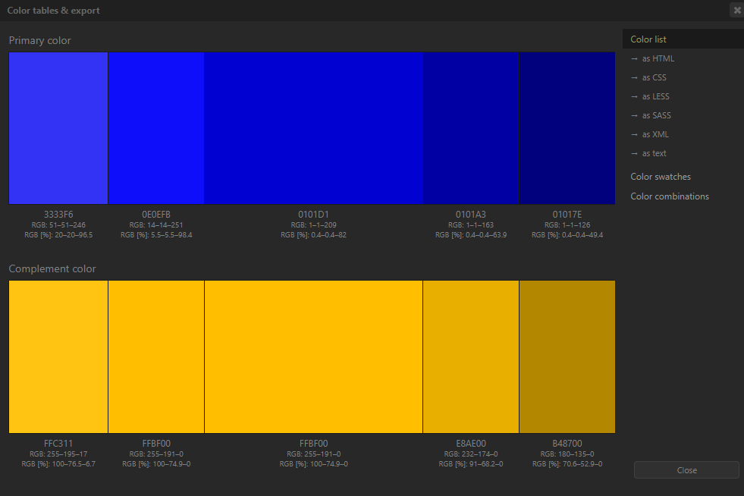

Slide 11
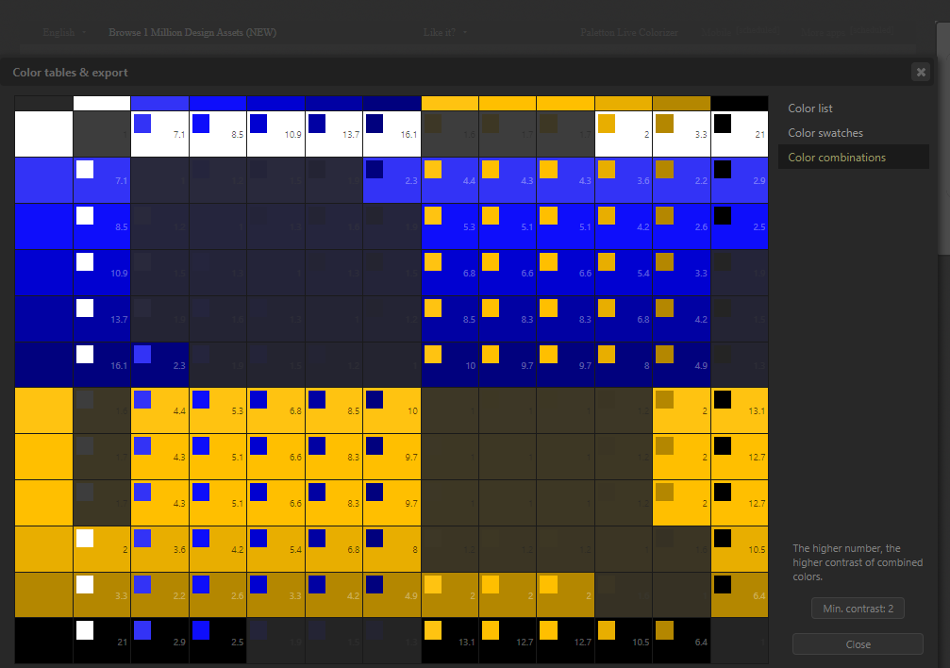

Slide 12
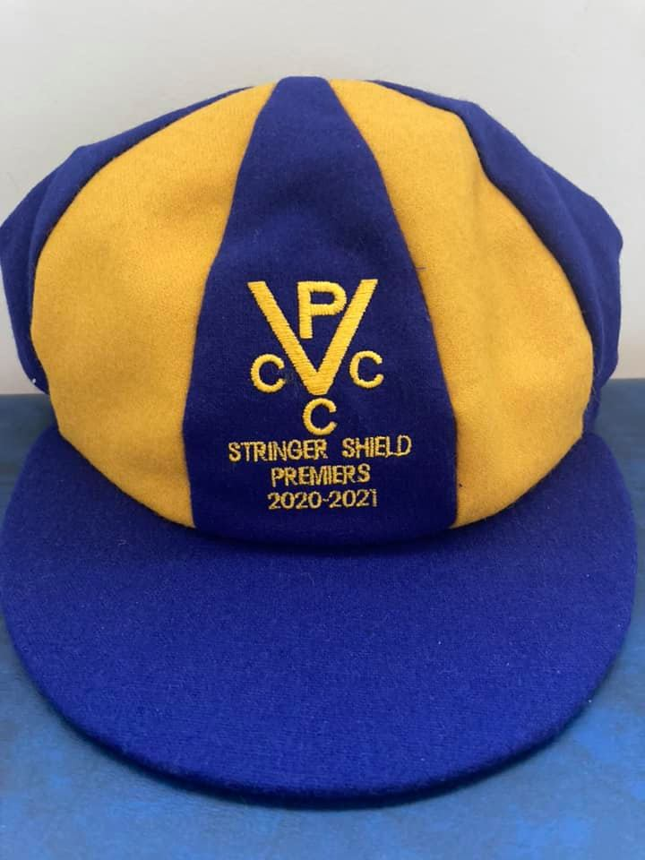

Logo ideas
Current
PASCOE VALE CENTRAL
CRICKET CLUB
19
28

Slide 13


Slide 14


Slide 15
INSPO

Slide 16


Slide 17


Slide 18


